Slide 1


CNNs architectures
Artemiy Firsov

Slide 2
5 minutes questionnaire
Convolution layer + stride/padding
MaxPooling
Training problems
Saturation, dead neurons
Overfitting
Features from CNN
What to visualize in CNN

Slide 3

Alexnet, 2012
Alex Krizhevsky, Ilya Sutskever, and Geoffrey Hinton
https://papers.nips.cc/paper/4824-imagenet-classification-with-deep-convolutional-neural-networks.pdf

Slide 4
Alexnet, 2012
Winner of 2012 ILSVRC (ImageNet Large-Scale Visual Recognition Challenge)
Trained on 2-х GPU GTX 580 during 5-6 days
15.4% top 5 test error rate
ReLU
Data augmentation
Dropout
SGD with momentum and weight decay (penalty of error function for big weights)

Slide 5
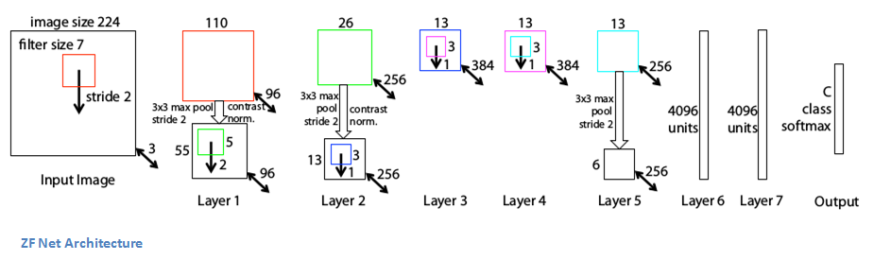
ZF net, 2013
http://arxiv.org/pdf/1311.2901v3.pdf

Slide 6
ZF net, 2013
Winner of 2013 ILSVRC (ImageNet Large-Scale Visual Recognition Challenge)
Slightly different from AlexNet
11,2% error rate
Authors provided intuitive explanations of CNNs + visualization techniques
First layer 7х7, not 11х11, to pass more information to the second layer
ReLU, cross-entropy, batch SGD
Trained 12 days on GTX 580 GPU
Authors invented Deconvolutional NN

Slide 7
VGG net D, 2014

Slide 8
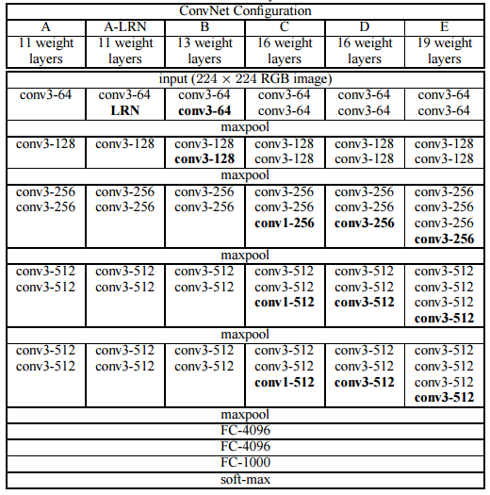

Slide 9
VGG net D, 2014
Winner (classification) of 2014 ILSVRC (ImageNet Large-Scale Visual Recognition Challenge)
7.3% error rate
3x3 consequent convolutions with stride/padding = 1, 2х2 maxpool with stride 2 – less parameters, but bigger perception field(2 convolutions 3х3 – perception field 5х5, 3 convolutions 3х3 – perception field 7х7)
Number of convolutions is doubled after each MaxPooling – decreasing spatial characteristics, but increasing depth
Build with Caffe
Trained on 4 Nvidia Titan Black GPUs during 2-3 weeks
Very popular!!

Slide 10
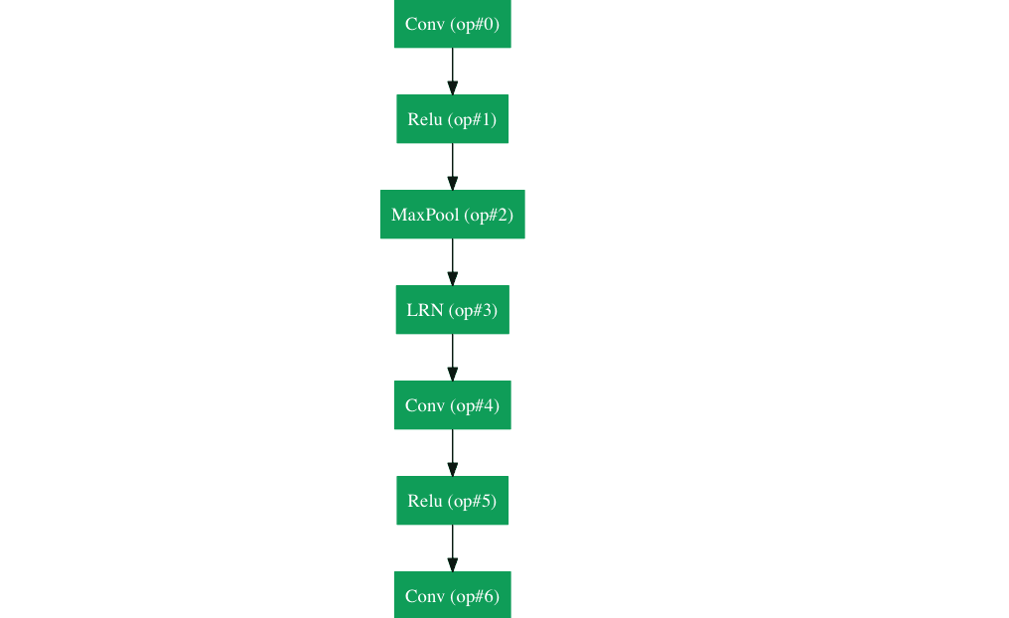
GoogLenet, 2015
http://www.cv-foundation.org/openaccess/content_cvpr_2015/papers/Szegedy_Going_Deeper_With_2015_CVPR_paper.pdf

Slide 11
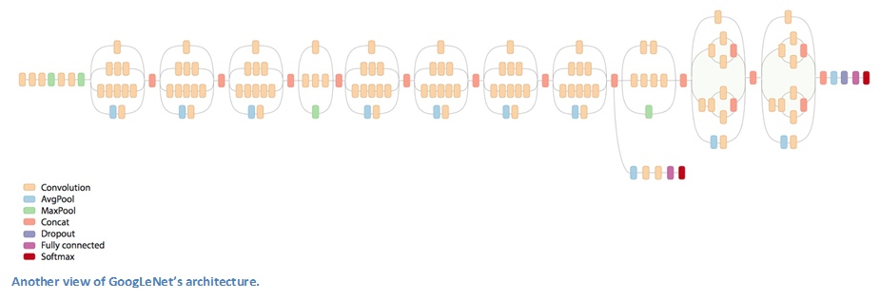
GoogLenet, 2015

Slide 12
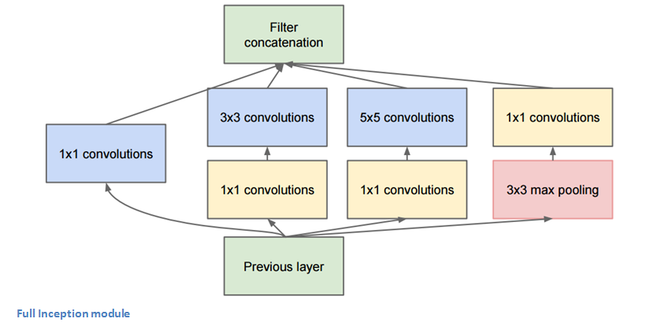
Inception module
Why do we need 1x1 convolutions?

Slide 13
GoogLenet, 2015
Winner (object detection) of 2014 ILSVRC (ImageNet Large-Scale Visual Recognition Challenge) – 22 layers
6.7% top 5 error rate
Used 9 Inception modules – more than 100 layers
Average pooling
Trained on “few high-end GPUs within a week”

Slide 14
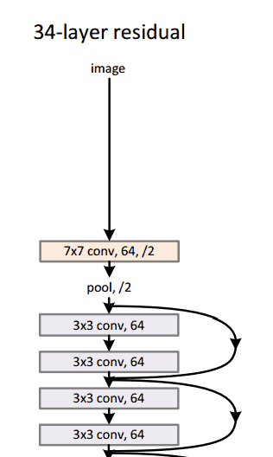
Microsoft resnet, 2015

Slide 15
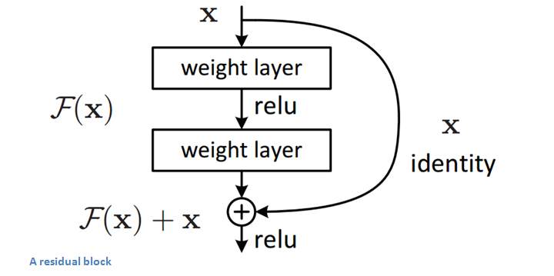
Residual block

Slide 16
Microsoft resnet, 2015
Winner of ILSVRC 2015
“Ultra-deep” – Yann LeCun – 152 слоя
First 2 layers - 224x224 –> 56x56
Tried architecture with 1202 layers, but bad test dataset performance
Trained on 8 GPU within 2-3 weeks
Error – 3.6% - better than a human

Slide 17
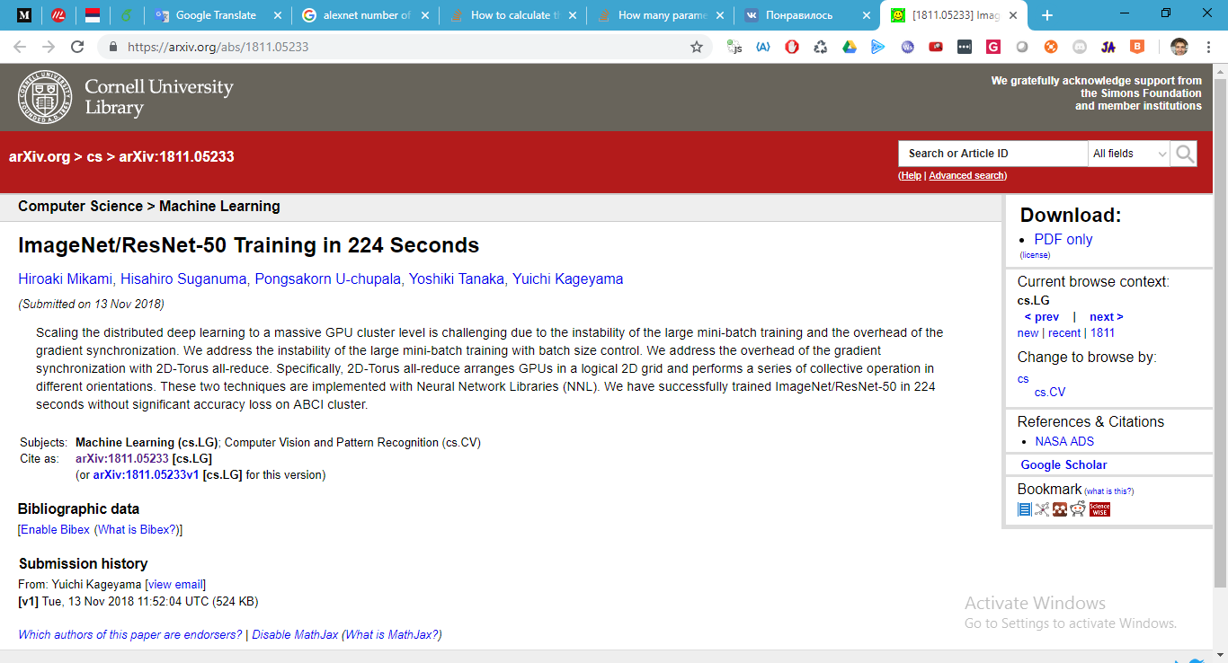
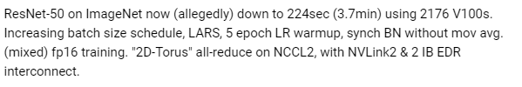

Slide 18
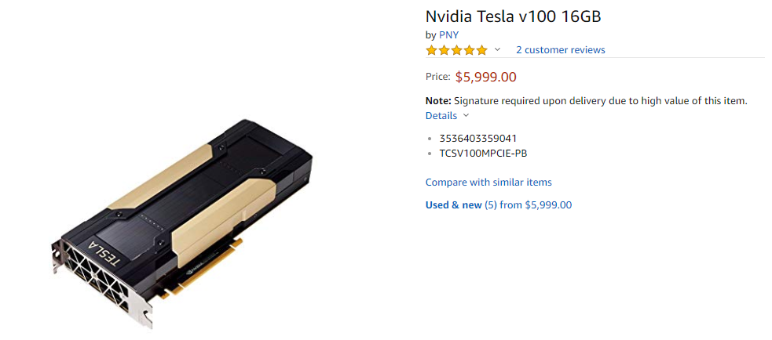
$5,999 * 2176 = $13,053,824
Very nice research ))

Slide 19
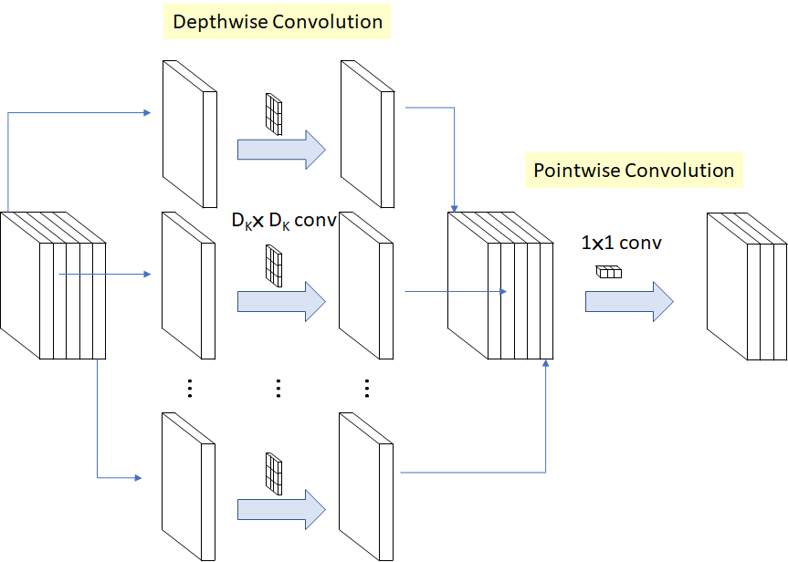
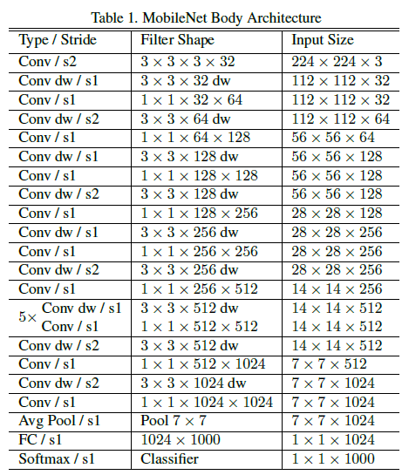
Mobilenet, 2017
Parameterized network width
Parameterized network input resolution
ResNet50 has ~23million weights, MobileNet - ~4.2 (and goes down to 0.2 with different parameters)

Slide 20
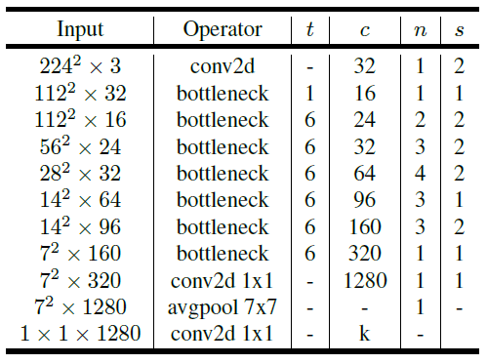
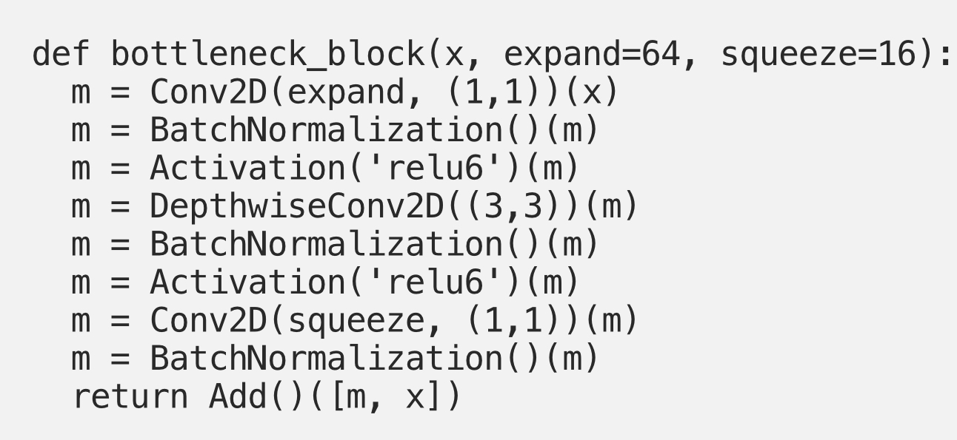
MobilenetV2, 2017
Inverted residuals with linear bottlenecks – reduce number of parameters to 3.4 millions

Slide 21
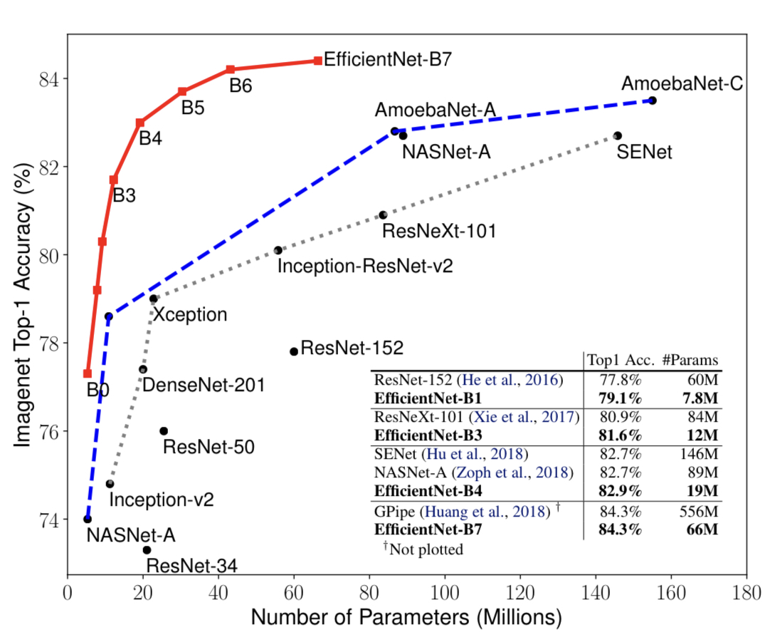
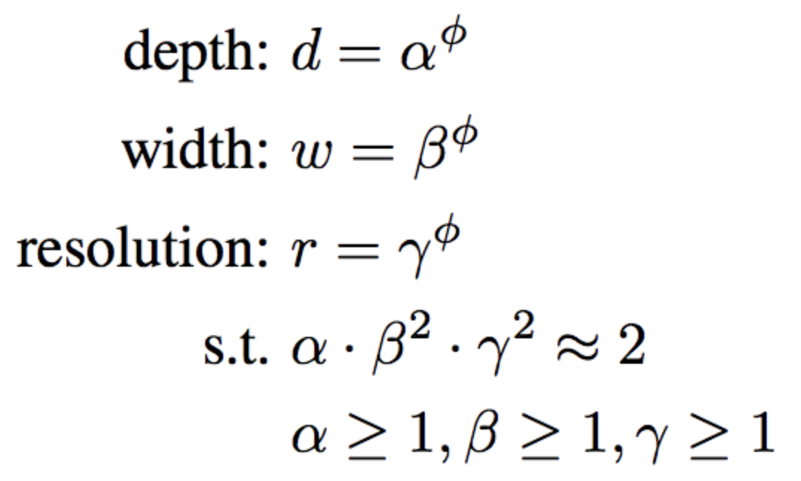
EfficientNet, 2019

Slide 22
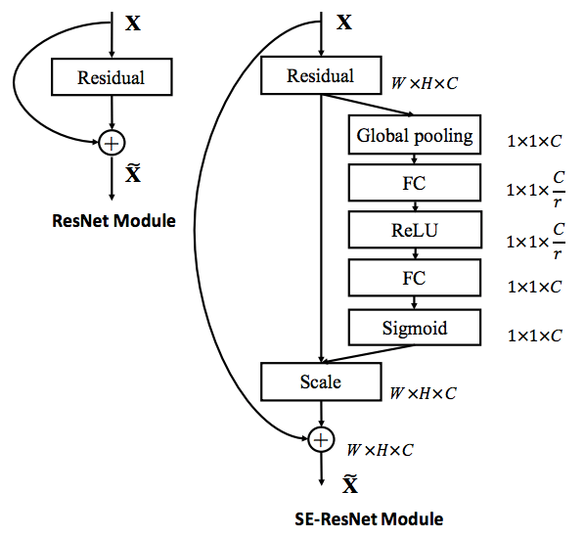
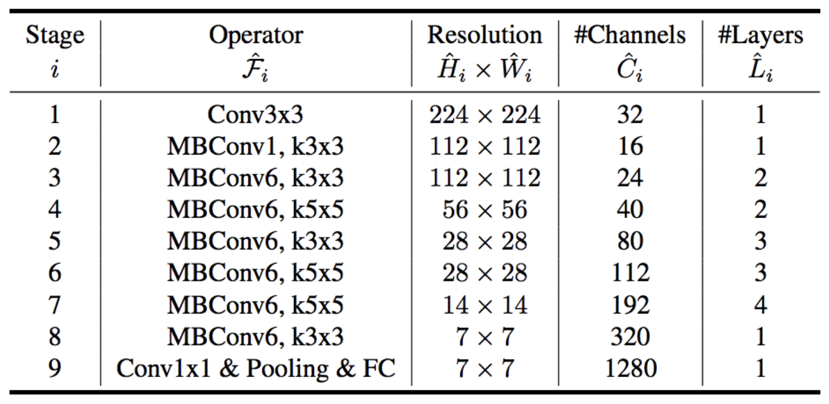
EfficientNet, 2019

Slide 23
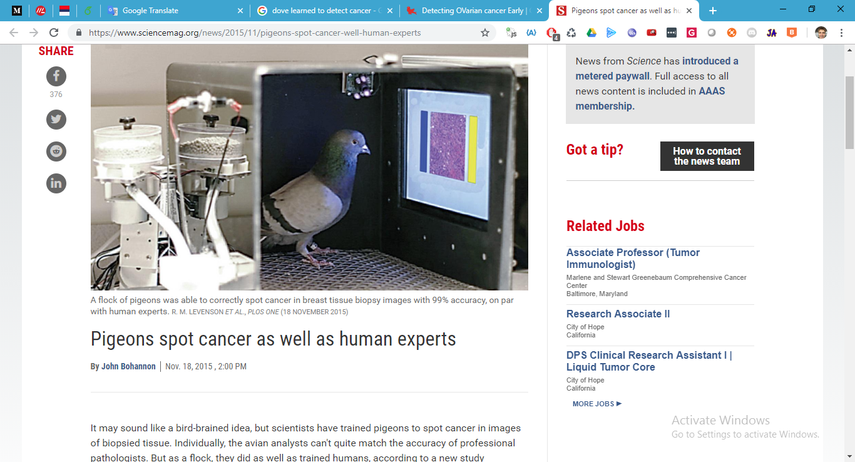

Slide 24
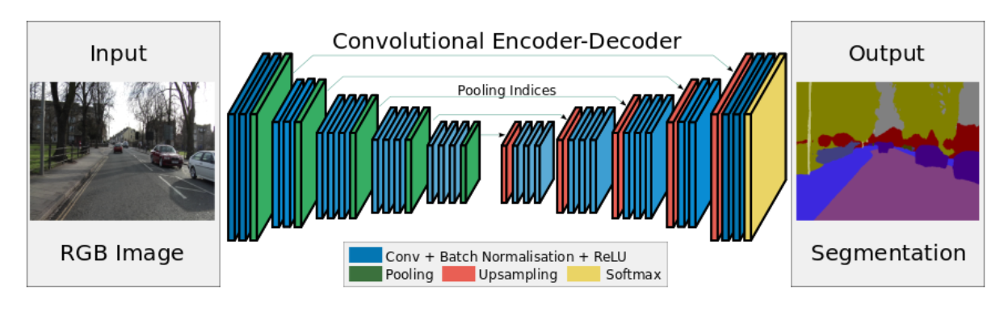
Segnet, 2015
Upsampling using the indices of max-pooled pixels in the encoder
Pretrained network

Slide 25
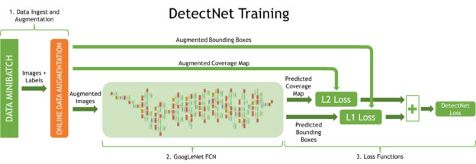
DetectNet – object detection

Slide 26
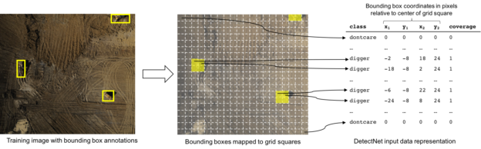

Slide 27
CNN tips
State-of-the-art architectures github repo

Slide 28
Style transfer

Slide 29
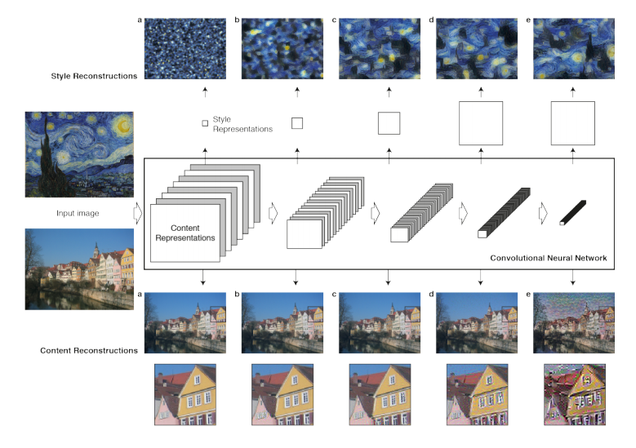
Перенос стиля
Trained network

Slide 30
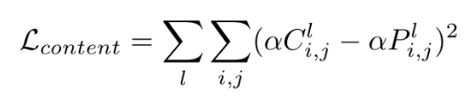
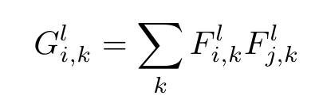
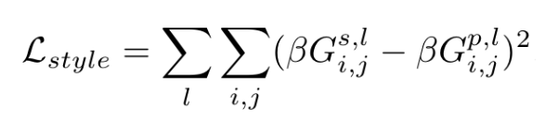
Style transfer
Difference between images on a certain layer
Gram-matrix – loses spatial information, but preserves texture info
Difference of «styles»

Slide 31
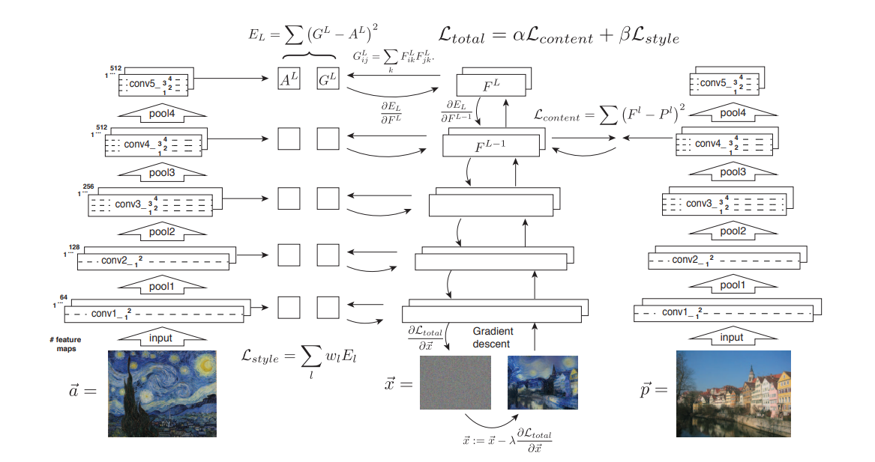

Slide 32
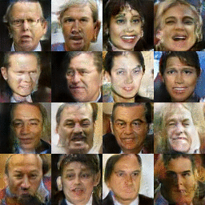
GAN
Generative Adversarial Network
To understand means to recognize (discriminative approach)
To understand means to reproduce (generative approach)

Slide 33
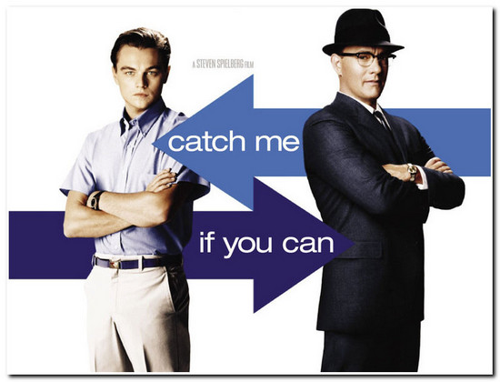
Idea
Строим 2 сети –фальшивомонетчика и банкира
Первая – порождающая, вторая – дискриминативная
Цель первой – обмануть банкира
Цель второй – распознать обман

Slide 34
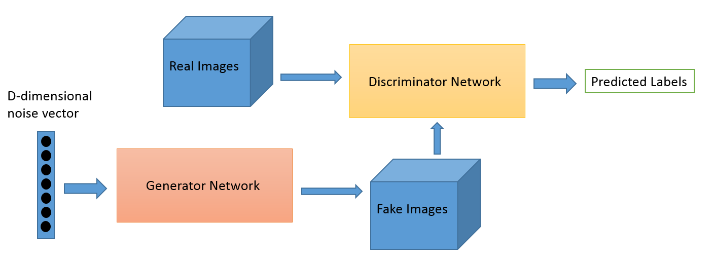
gan

Slide 35

gan

Slide 36
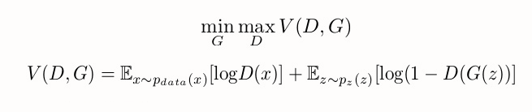
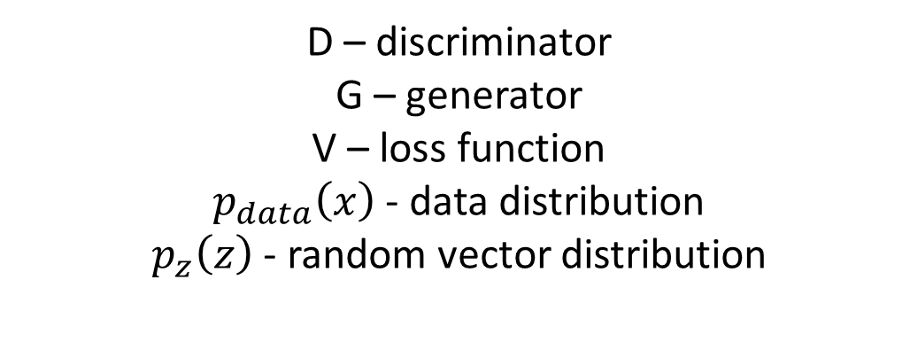
gan
D – discriminator
G – generator
V – loss function
$p_{data}\left(x\right)$ - data distribution
$p_{z}\left(z\right)$ - random vector distribution
Train discriminator with static generator
Train generator with static discriminator
Repeat

Slide 37
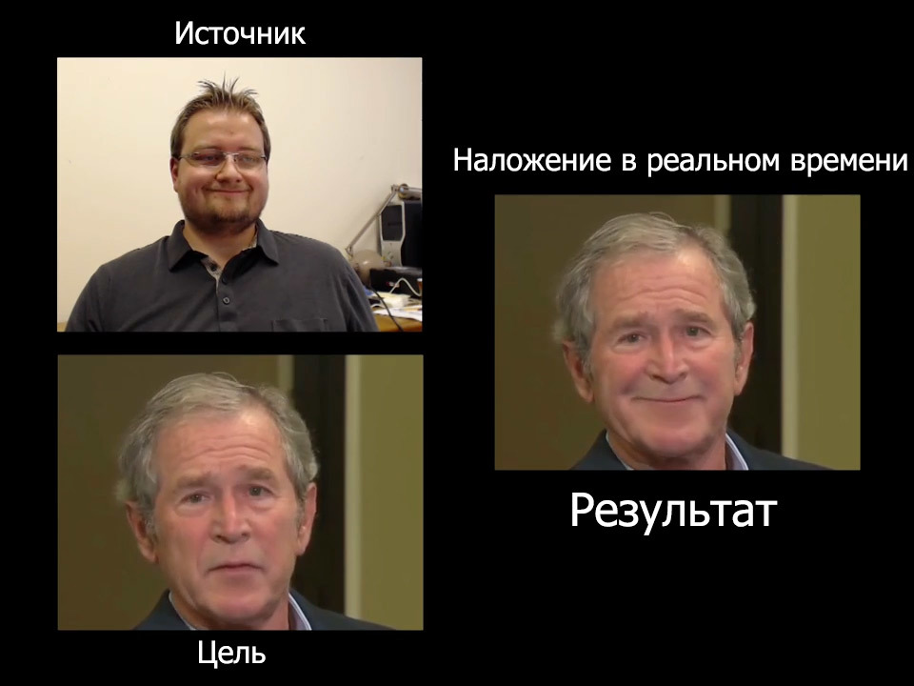
face2face

Slide 38
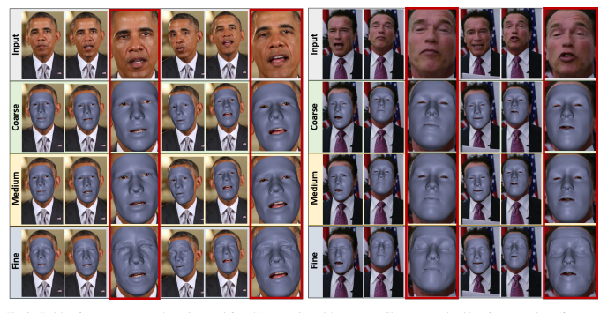

Slide 39
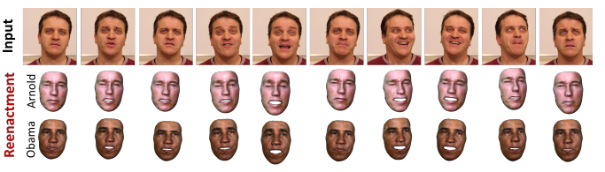

Slide 40
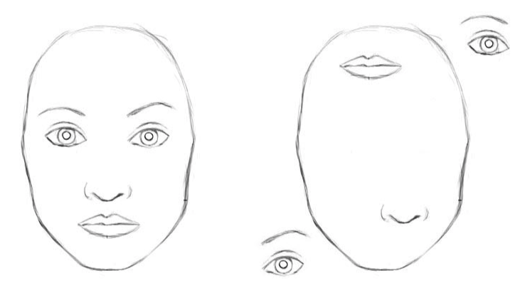
Capsule networks, 2017
For the CNN this images likely would look the same

Slide 41
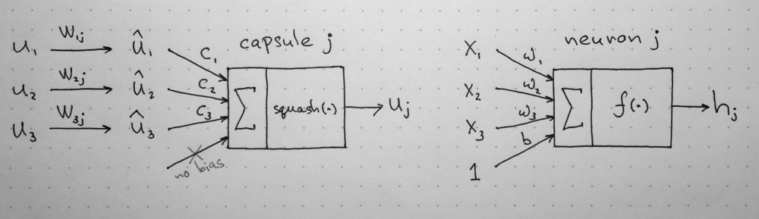
Capsule networks, 2017
Neuron is the summation of scalar multiplication o weights – this gives us another scalar
But what if we output a vector which characterizes local part of the image - capsule
And also the one that is invariant to scale and shift

Slide 42
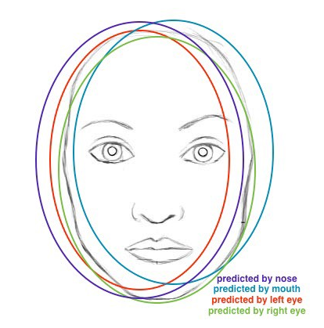
Capsule networks, 2017
Capsule detecting face inputs capsule of nose, eyes, mouth, ears.
Weight matrices in that case can be the analogue of affine transformation

Slide 43
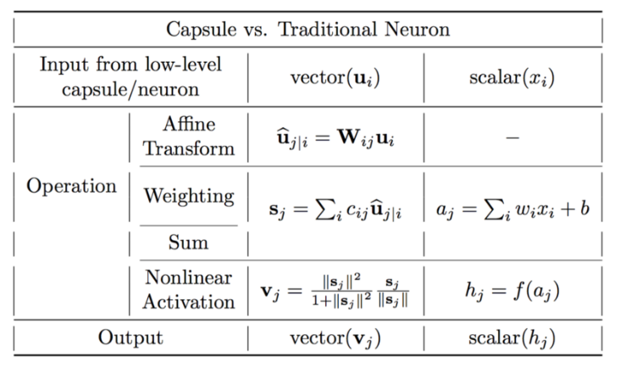

Slide 44
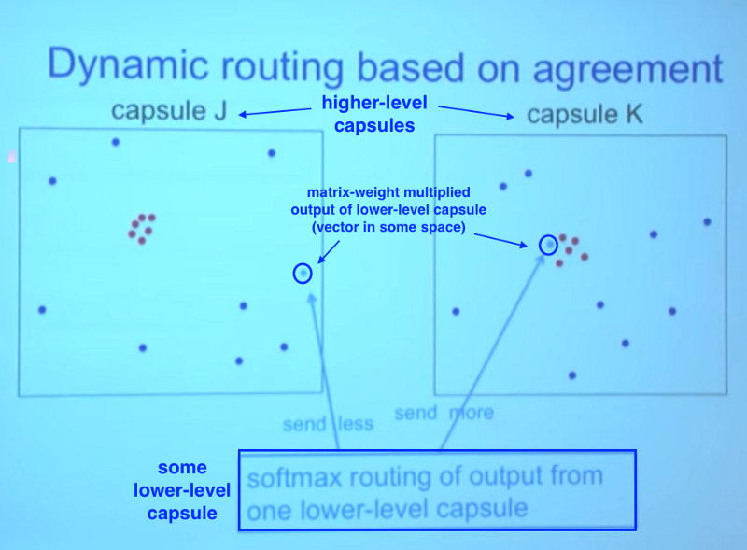

Slide 45
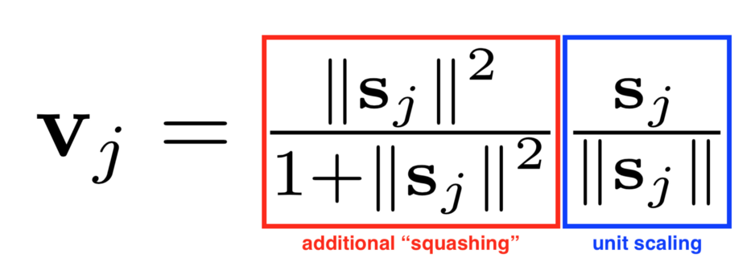
squashing

Slide 46
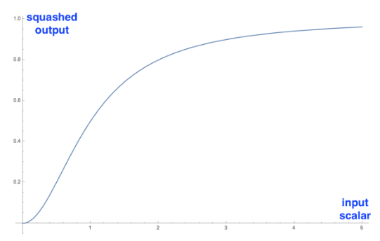
squashing

Slide 47
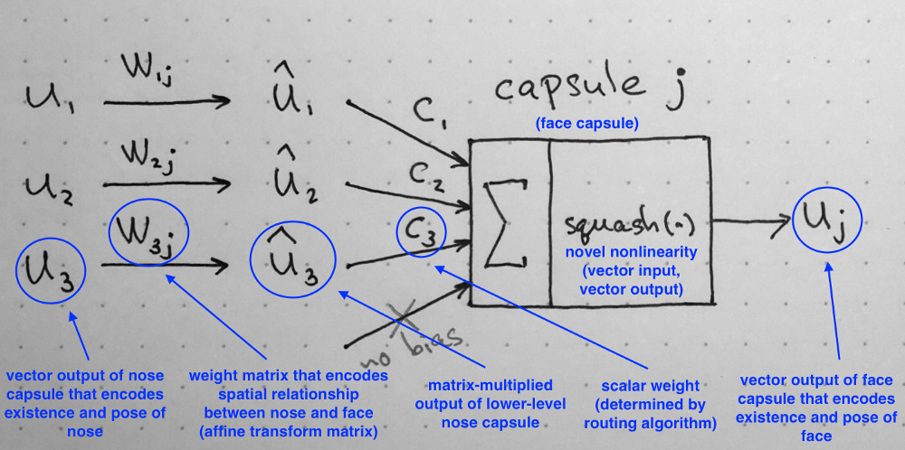

Slide 49
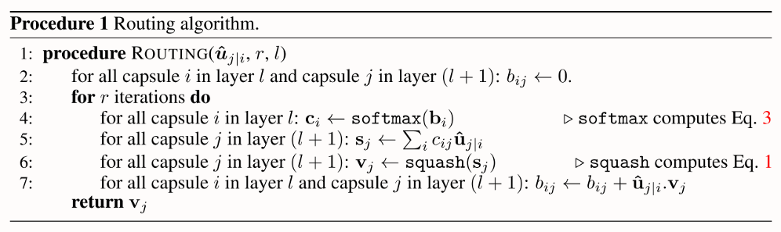
Dynamic routing

Slide 50
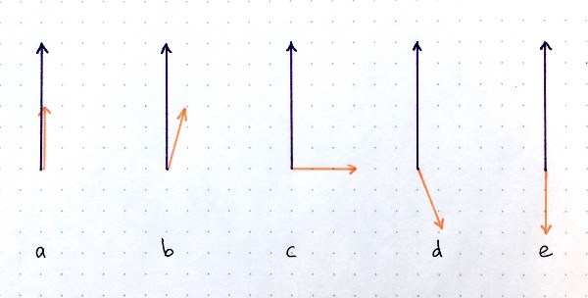
Dynamic routing
Step 7

Slide 51
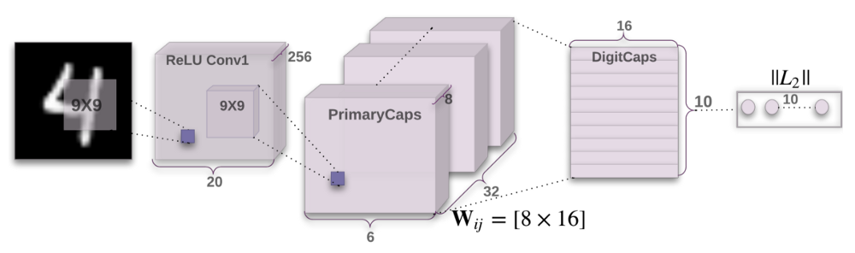
Capsnet architecture
6x6x8х32 = 6х6х32х8
28x28
3 FCL
9x9x256 convolutions form 32 capsules

Slide 52
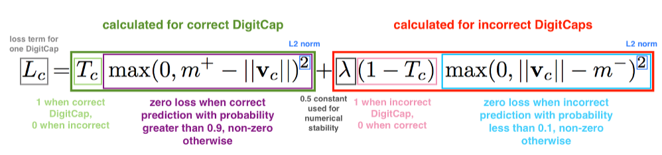
Loss function

Slide 53
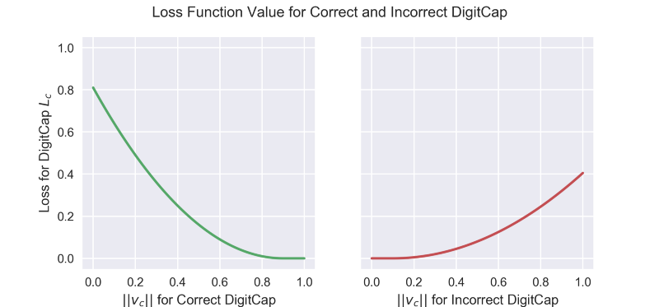

Slide 54
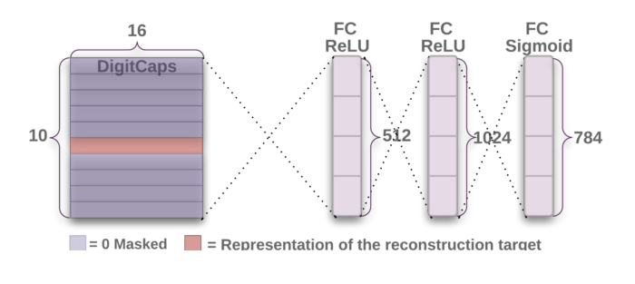
decoder

Slide 55
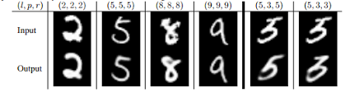
decoder

Slide 56
More info
State-of-the-art architectures
VK1
VK2
ODS Siberia

Slide 57
Thank you!

